Slide 1


The PCA program of the project of predicting the taxiing time of aircraft at Manchester Airport
by Group B

Slide 2
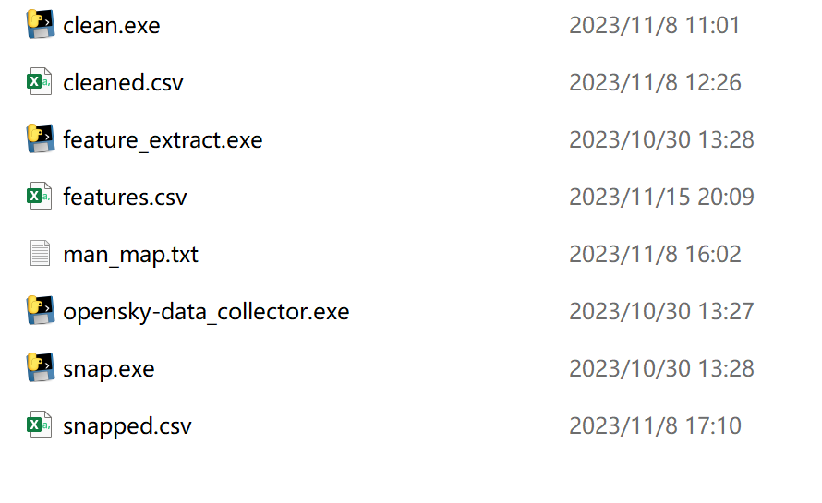
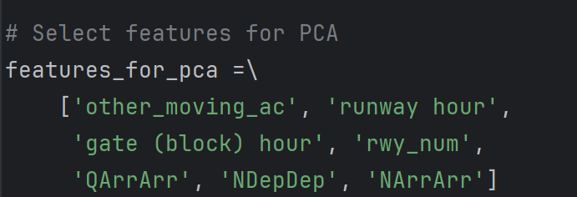
Part one：Data Set Description
Ⅰ. Data collection & processing
Ⅱ.Data selection
Use the program provided by QMplus, man_ Map.txt and the cleaned dataset from March 2021 are placed in the same directory, as shown in the following figure.
Run snap.exe to obtain the snaped.csv dataset
Run feature_ Extract. exe obtains the feature set: features. csv
The data selection process is the process of selecting certain features from a feature set and inputting them into a PCA program.
Principle: Retain the features most relevant to aircraft taxiing time, and the correlation between these features must be low. Warining: taxi_ time is the target variable and should not be selected as a feature.
Process: Exclude obvious unrelated features, exclude features with correlation coefficients greater than 0.9 in correlation analysis, and remove features with small contributions in the principal components. Finally, the following seven features were retained

Slide 3
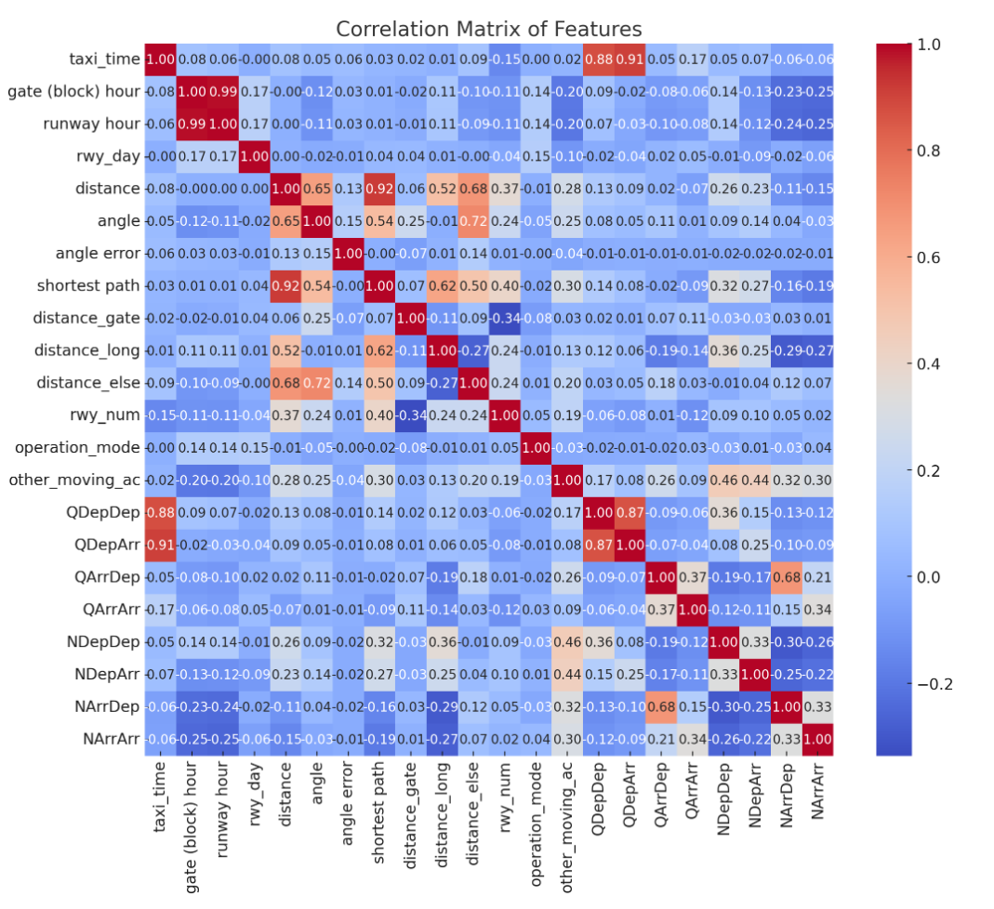
Part one：Data Set Description
Ⅲ.How to select the features
Step 1. Manual screening
Utilize professional knowledge to exclude features that are least relevant to the problem and remove features that are meaningless or unavailable in actual scenarios
Step 2. Correlation analysis
Calculate the correlation coefficient and generate a correlation coefficient matrix, which is visualized through a thermal diagram. Determine the correlation threshold (0.9) and remove one of the highly correlated feature pairs.
Step 3. Principal component analysis fitting
After executing PCA, check the load situation of the principal components and calculate the square load (contribution rate) of each feature. The larger this value, the more important the feature is. All 7 features mentioned above are ultimately preserved.

Slide 4
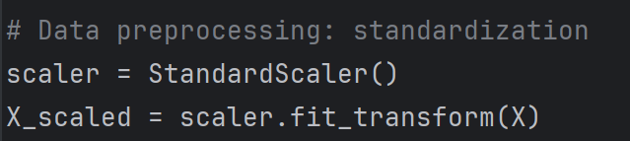
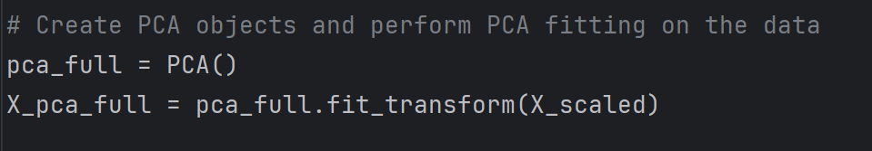
Part one：Data Set Description
Ⅳ.Preparation of PCA
Step 1. Data standardization
Scaling all features to the same dimension ensures fair treatment of each feature when calculating principal components.
Step 2. Creat principal components
Step 3. Principal component analysis fitting
Include: Calculate the covariance matrix of the data, the eigenvalues and eigenvectors of the covariance matrix. Then, the eigenvectors (i.e. principal components) are sorted based on the size of the eigenvalues.

Slide 5
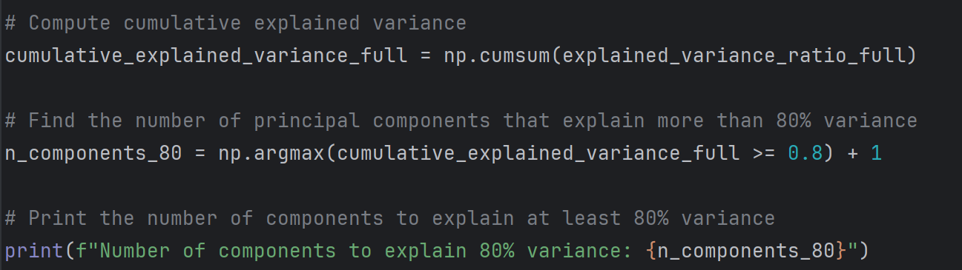
Part two:
Steps taken during the PCA analysis and interpreting results
1
Compute Principal Components
The program calculates the principal components of the data using the PCA() function.
2
Choosing the appropriate number of principal components
Determine the main principal component number required to explain at least 80% of the variance by analyzing the cumulative explanatory variance.

Slide 6
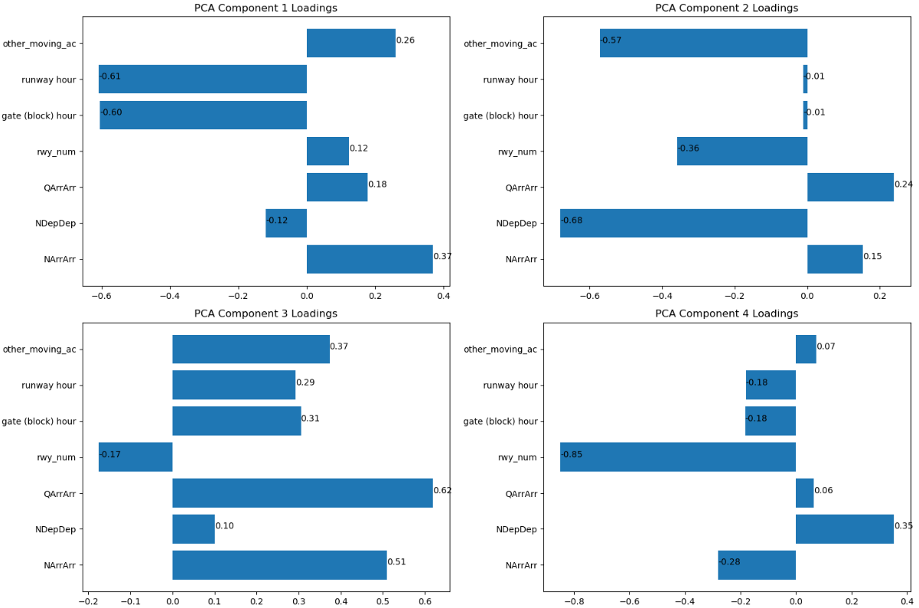
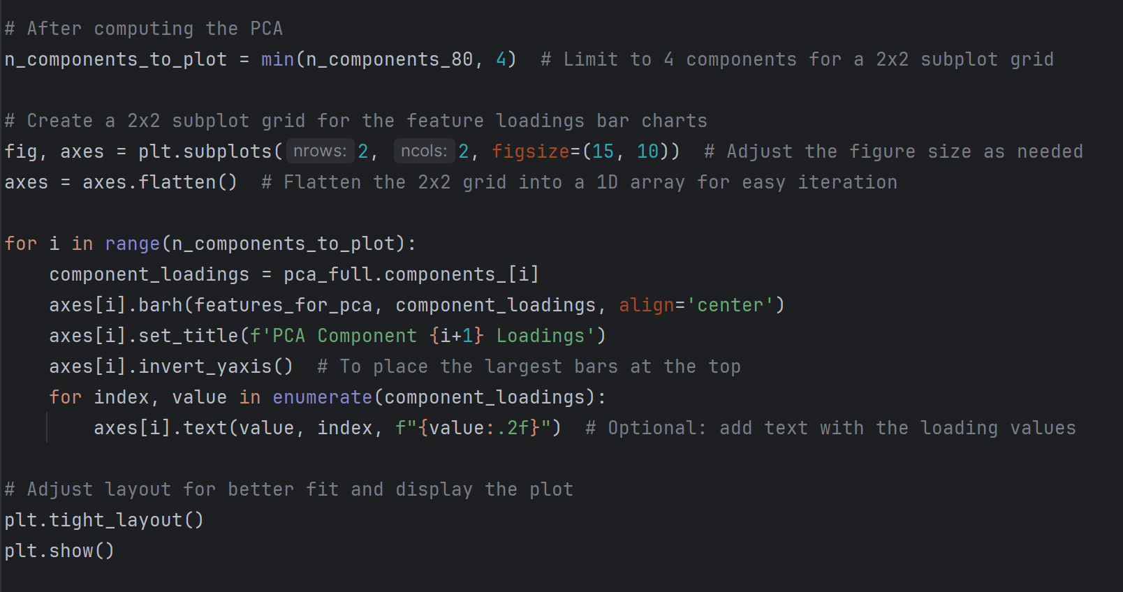
Part two：
Steps taken during the PCA analysis and interpreting results
3
Interpreting the principal components and feature importance
The program prints the explained variance ratio for each principal component and visualizes the feature loadings (importance of each feature) for each component in bar charts.

Slide 7
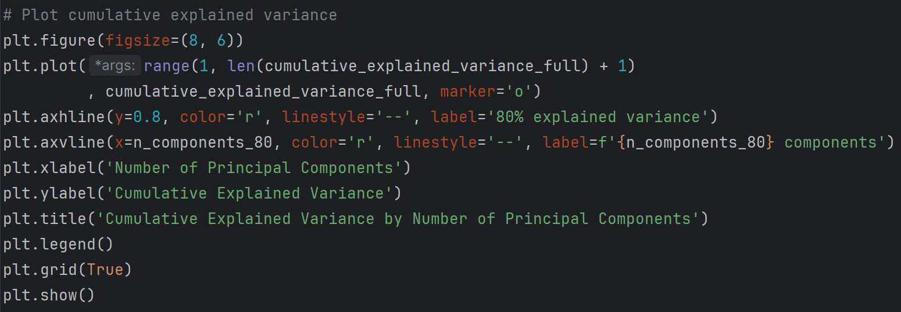
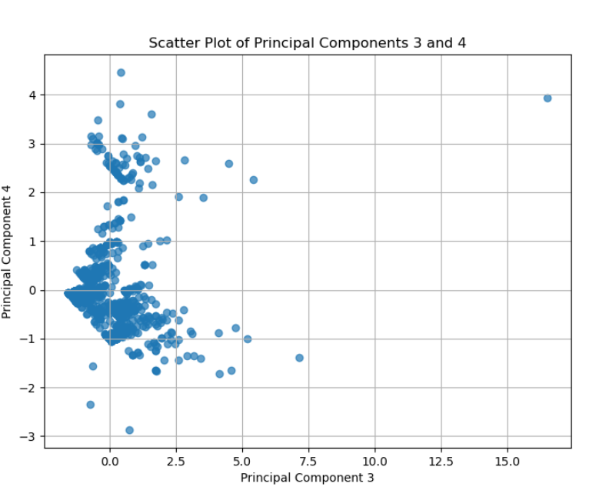
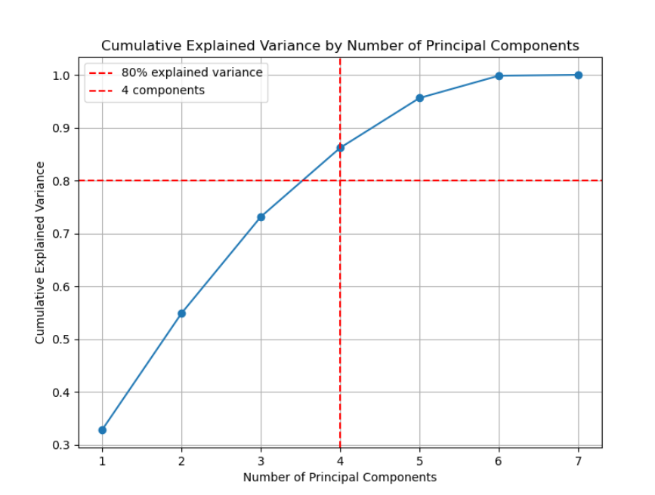
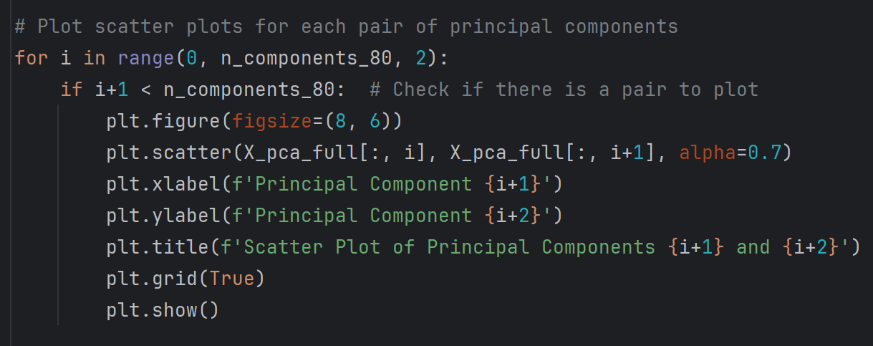
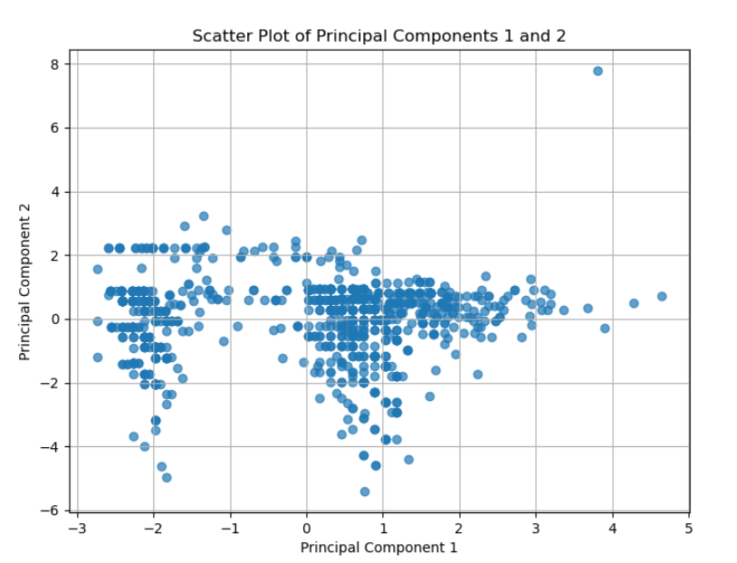

Part two：
Steps taken during the PCA analysis and interpreting results
4
Plotting selected principal components
It generates visualizations, including the cumulative explained variance curve, bar charts showing feature loadings, and two scatter plots of pairs of principal components.

Slide 8
Part two:
Steps taken during the PCA analysis and interpreting results
1
Compute Principal Components
The program calculates the principal components of the data using the PCA() function.
2
Choosing the appropriate number of principal components
Determine the main principal component number required to explain at least 80% of the variance by analyzing the cumulative explanatory variance.

Slide 9
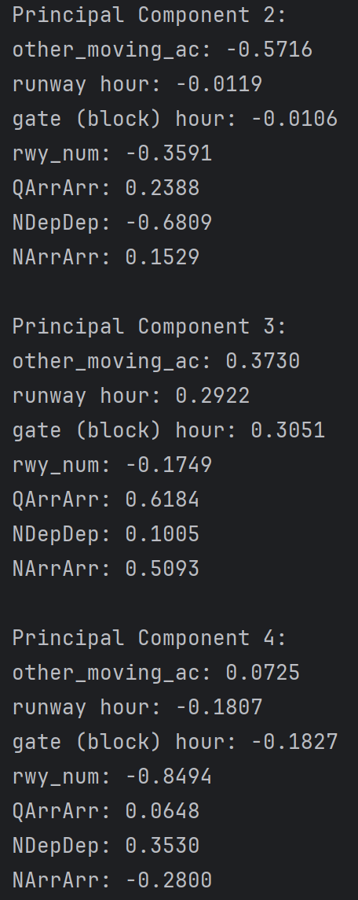
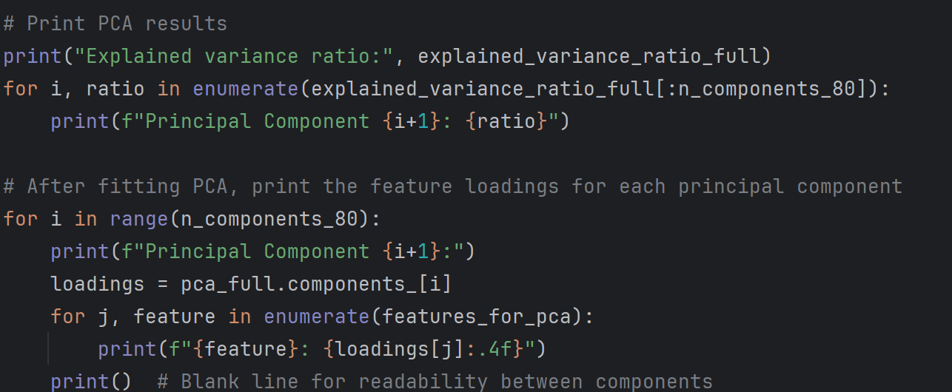
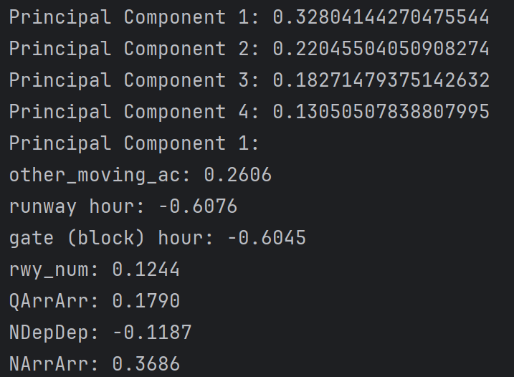
Part two:
Steps taken during the PCA analysis and interpreting results
5
Assessing the information loss
Based on the printed variance ratio of the explanation and the cumulative variance curve of the explanation, it can be inferred that 13%

Slide 10
Part three: future plan
A future plan on the modelling and prediction of taxi time to complete the final group report.
* * Feature Engineering improvement * *: Further explore and select features related to taxi time.
* * Data Segmentation * *: Divide the dataset into training and testing sets, using 70-80% of the data as the training set, and the rest for testing.
* * Model Selection * *: Try 3 different machine learning models: neural networks, linear regression, and Adaptive-Network-based Fuzzy Inference Systems (NN, LR, and ANFIS), and evaluate their performance in predicting sliding time.
* * Model Training * *: Use training data to train the selected model and tune it to improve its performance.
* * Model Evaluation * *: By using a test set to evaluate the performance of the model to ensure that it can accurately predict aircraft taxiing time

